Slide 1
JAVA 2 Platform, Enterprise Edition
Web development using Java

Slide 2
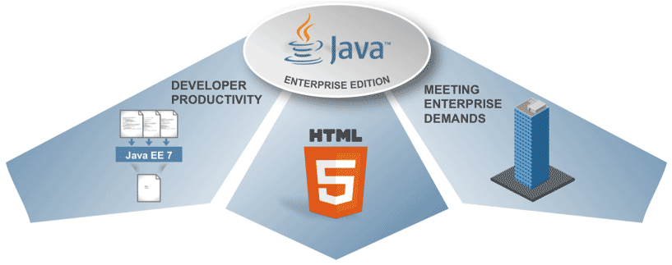
Overview on J2EE

Slide 3

What is J2EE?
Open and standard based platform for developing, deploying and managing n-tier.
Web-enabled, server-centric, and component based enterprise applications.

Slide 4
What is an Enterprise Application?
Enterprise application is mostly composed of:
Business Logic
Presentation Logic
Data Access Logic (and Data Model)
System services

Slide 5
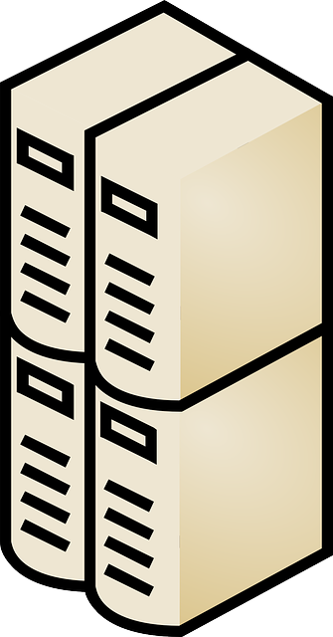
Single-Tier
Client

Slide 6

Two-Tier
PC
SQL RESPONSE
SQL REQUEST
PC

Slide 7
Three-Tier
RPC Request
SQL Request
PC
PC
RPC Response
SQL Response
Notes:
Remote Procedure Call(RPC)

Slide 8
Life-cycle of J2EE
Creation
Assembly
Deployment
Created by Component Developer.
Assembled and Augmented by Application Assembler
Processed by Developer
J2EE Container
Enterprise Components

Slide 9
J2EE Structure
WEB.XML – Deployment Descriptor
VIEWS
Composed of JSP or HTML
CONTROLLER
Servlets
DAO
Object Dao
MODEL
Beans
DB UTILITIES
Database Connection

Slide 10
Spring MVC Framework
Annotation-driven programming
Notes:
is an application framework and inversion of control container for the Java platform. The framework's core features can be used by any Java application, but there are extensions for building web applications on top of the Java EE platform.

